Slide 1
FOUNDATIONS OF DATA SCIENCE ASSIGNMENT (GROUP 2)
Team Members:
Vivek Iyer (21BCE0157)
Aman Kumar (21BCE2276)
Adrish Srivastava (21BCE0446)
Sarthak (21BCE3231)
Dhruv (21BCE2736)
Gajevalli (21BDS0248)
1

Slide 2
PHASE 1: DATA DISCOVERY
2
Learning the Business Domain
Gain deep industry insights, focusing on animal health conditions, diagnostics, and impacts.
Understand the critical aspects of the veterinary domain to
inform the development of a robust predictive model.
Resources Available
Utilize time efficiently by leveraging the expertise of data scientists and veterinarians.
Employ cutting-edge data analysis tools and technologies for
a comprehensive understanding of animal health conditions.
Utilize available data resources, including health records and
symptom data, to enhance project success.

Slide 3
PHASE 1: DATA DISCOVERY
3
Framing the Problem
Define the challenge of developing a predictive model for animal health conditions.
Emphasize the importance of utilizing symptom data and other relevant information for accurate classification.
Highlight the potential impact of the predictive model on improving animal healthcare.
Identifying Key Stakeholders
Engage with veterinarians, care providers, and researchers as key stakeholders.
Align project objectives with the needs and expectations of the veterinary community.
Emphasize collaboration for a holistic understanding of the challenges and opportunities in animal health.

Slide 4
PHASE 1: DATA DISCOVERY
4
Interviewing the Analytics Sponsor
Interview the analytics sponsor to clarify the project scope, objectives, and success metrics.
Ensure alignment with the sponsor's vision to enhance the project’s
impact and relevance.
Establish a clear understanding of expectations to guide the development of the predictive model.
Developing Initial Hypothesis
Formulate initial hypotheses on symptom patterns and their potential
ppredictive value for different health conditions.
Emphasize the iterative nature of hypothesis development and refinement based on data analysis.

Slide 5
PHASE 1: DATA DISCOVERY
5
Identifying Potential Data Sources:
Explore diverse data sources, including veterinary records, research databases,
and online datasets.
Highlight the significance of collecting comprehensive data to ensure a robust and generalizable predictive model.
Emphasize the need for ethical considerations and data privacy compliance in the acquisition of relevant data.

Slide 6
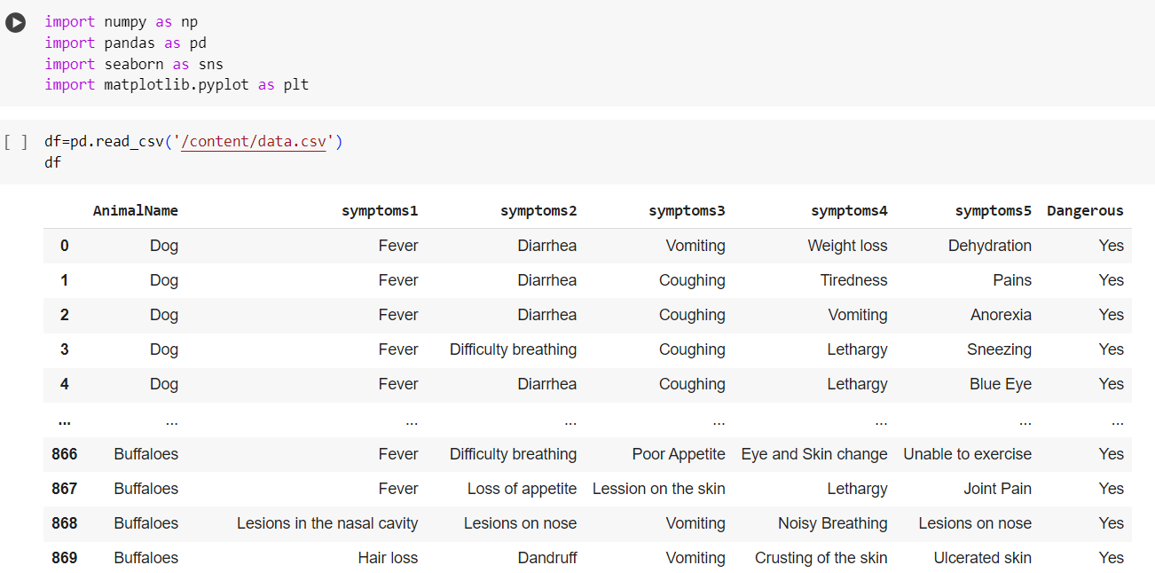

Slide 7
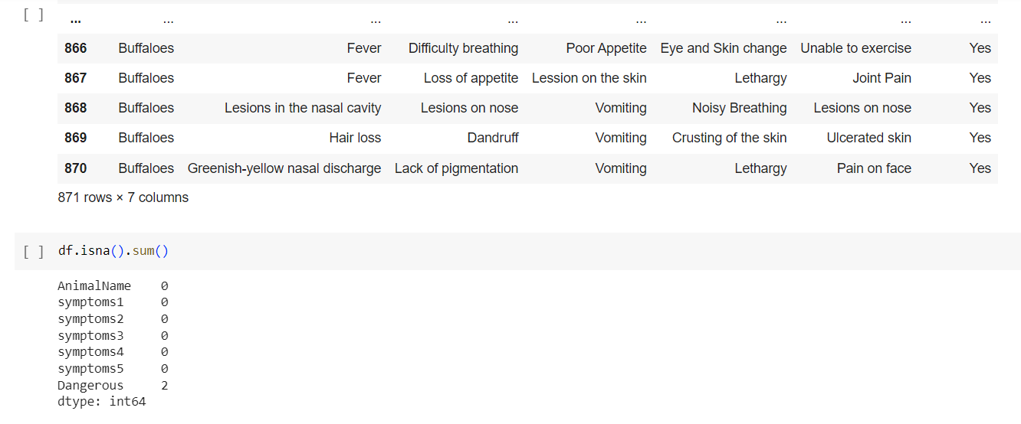

Slide 8
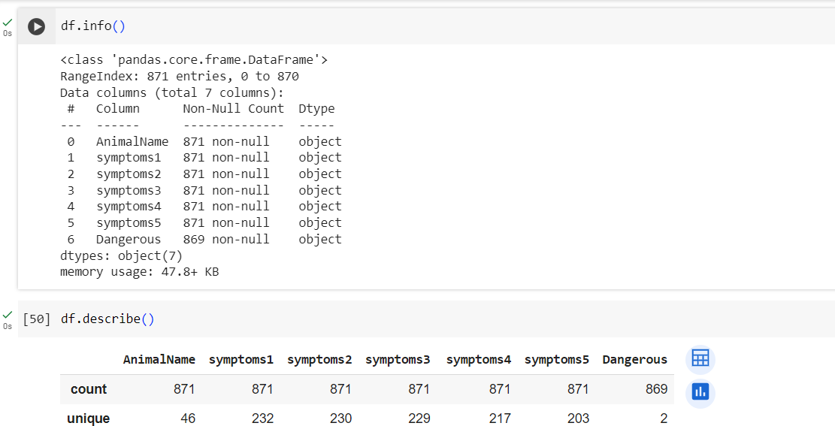

Slide 9
PHASE 2: DATA PREPARATION
Preparing Analytic Sandbox
Establishing a controlled environment for data exploration, enabling a clear understanding of the dataset.
Data Exploration and Preparation
Performing ETLT
Extract: Retrieved data from a CSV file on Kaggle containing animal symptoms and their corresponding health conditions.
Transform: Cleaned and transformed the data to ensure consistency and suitability for analysis.
Load: Loaded the transformed data into our Python environment for further processing.

Slide 10
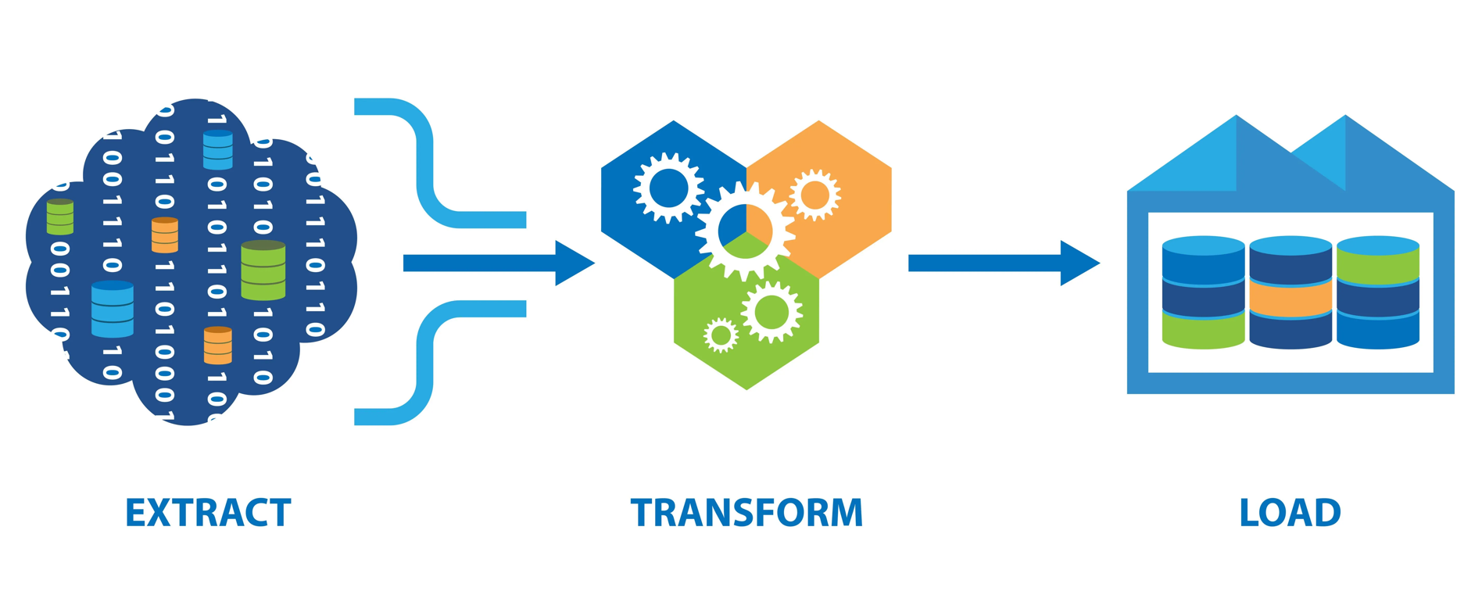

Slide 11
PHASE 2: DATA PREPARATION
Learning about the Data
Source: Public data repository.
Structure: Explored the data structure, identifying 871 rows (data points) and 7 columns .
Data Conditioning
Missing Values: Handled missing values (2 entries) by dropping the corresponding rows to maintain simplicity
Duplicate Rows: Addressed duplicate rows
Categorical Data: Encoded
categorical data (animal names, symptoms)

Slide 12
PHASE 2: DATA PREPARATION
Survey and Visualize
Explored data distribution: Used descriptive statistics (mean, median, standard deviation) to understand the distribution of features and the target variable.
Created visualizations: Generated visualizations like bar plots, line charts and pie charts to identify patterns and trends in the data. This helped us gain valuable insights into the distribution of animal conditions and the relationships between features.
Tools for Data Preparation
pandas: Provided powerful tools for data manipulation and cleaning tasks.
Seaborn and Matplotlib: Powerful tools for data visualization.

Slide 13
PHASE 3: DATA PREPARATION
Significance of a Heatmap
Feature Importance: Visualizing the impact of features on model predictions.
Model Evaluation: Analysing model performance through confusion matrix heatmaps.
Hyperparameter Tuning: Optimal hyperparameter selection via heatmap visualization.
Attention Mechanisms: Understanding model focus areas in tasks like NLP and image recognition.
Correlation Analysis: Detecting feature correlations in high-dimensional data.
Error Analysis: Investigating model confidence and errors for improvement.
Interpretability: Enhancing model interpretability, e.g., through saliency maps in image classification.

Slide 14
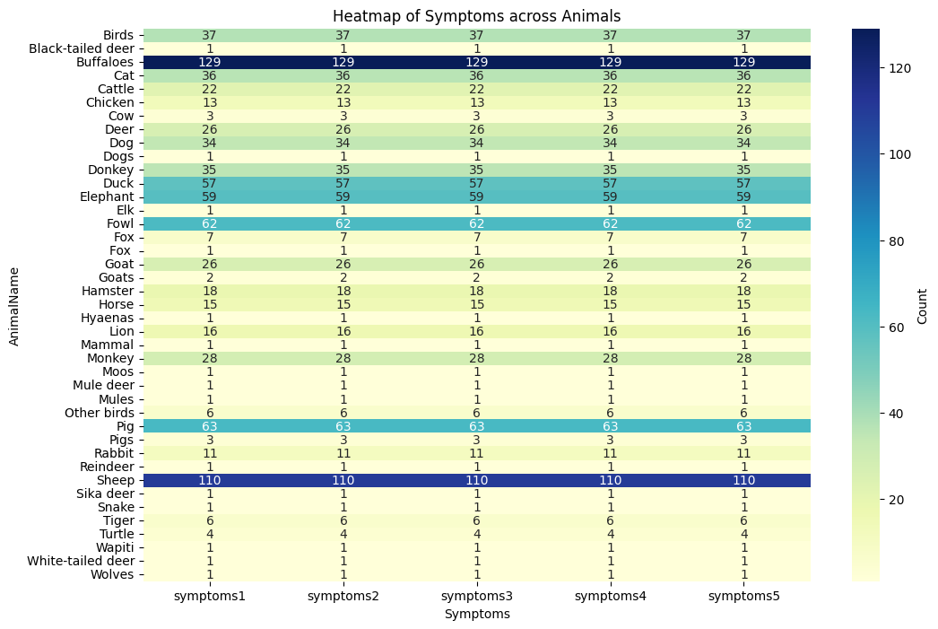

Slide 15
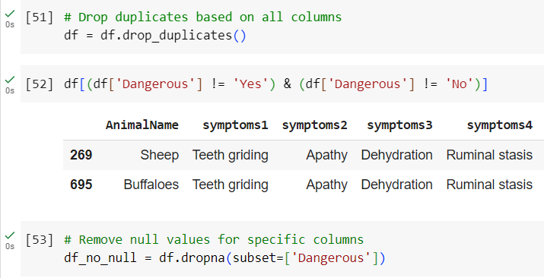

Slide 16
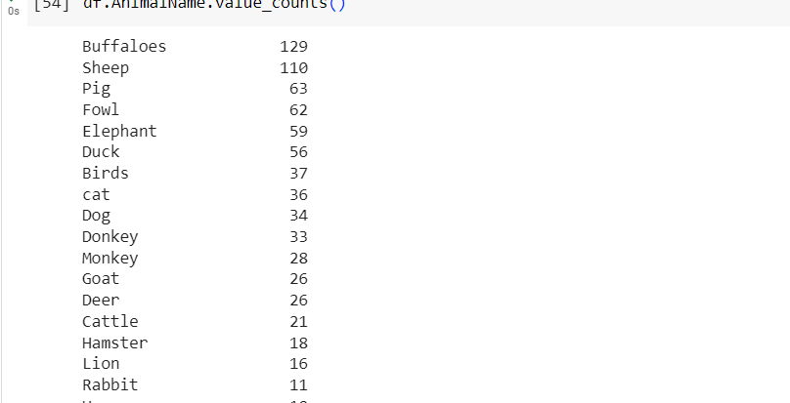

Slide 17
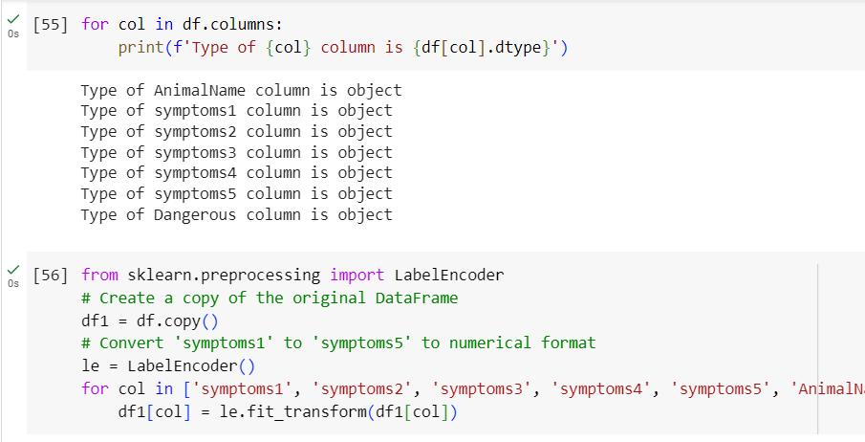

Slide 18
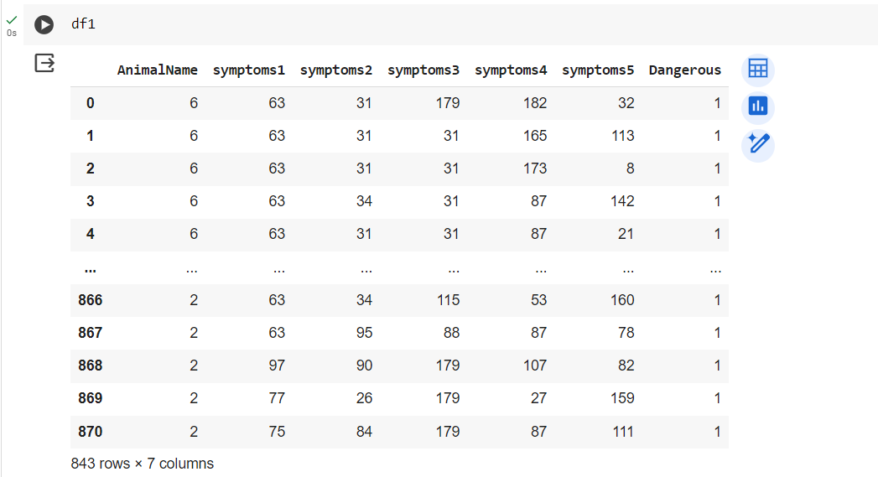

Slide 19
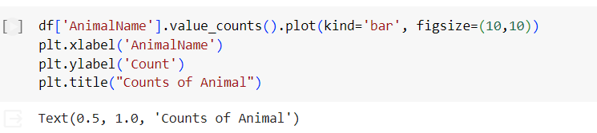

Slide 20
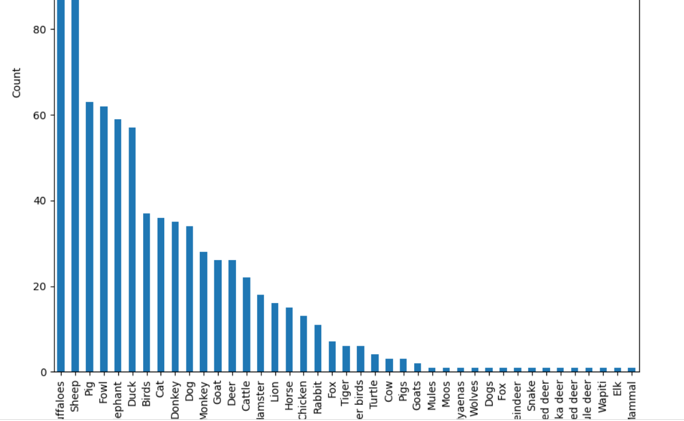

Slide 21
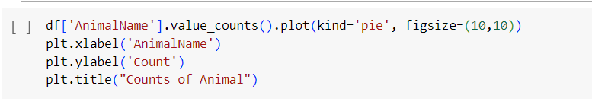

Slide 22
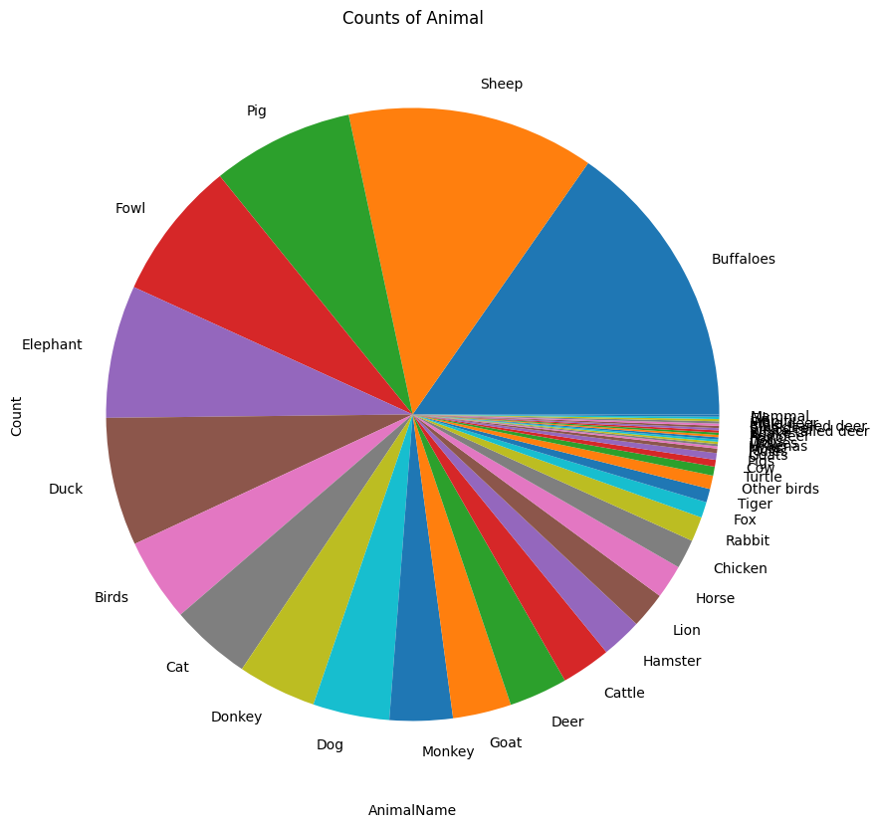

Slide 23
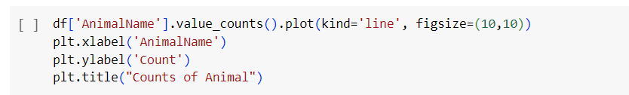

Slide 24
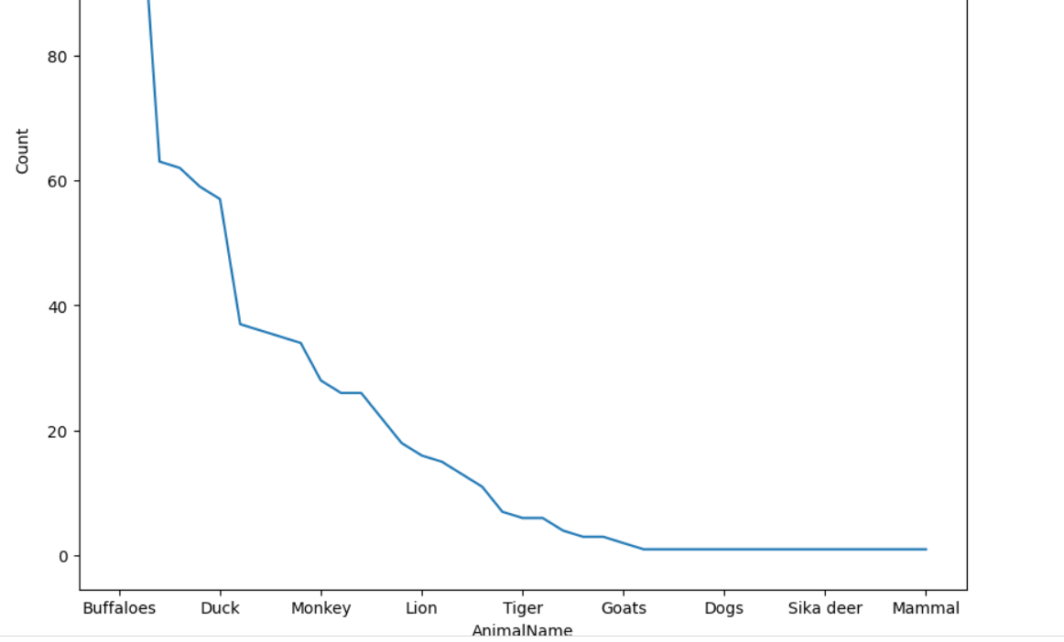

Slide 25
PHASE 3: MODEL PLANNING
Data Exploration:
Data Cleaning and Imputation:
▶ Implemented the SimpleImputer from sklearn.impute to handle missing values, ensuring a clean dataset for analysis.
Relationship Analysis:
▶ Conducted a relationship analysis between the 'AnimalName' column and symptoms 1-5. This process
enhances our understanding of how these variables contribute to the classification task.
Data Visualization:
▶ Utilized data visualization libraries, including matplotlib and seaborn, to create a heatmap illustrating the
distribution of symptoms across different animals. This visual representation aids in identifying patterns and
correlations.

Slide 26
PHASE 3: MODEL PLANNING
1. Data Exploration and Variable Selection:
Features: The dataset (df1) includes information about animals, and features include the type and 5 symptoms.
Target Variable: 'Dangerous' is selected as the target variable.
Data Splitting: The dataset is split into training and testing sets using a 75-25 ratio.
2. Model Selection
Algorithm: Support Vector Machine (SVM) with a linear kernel is chosen for classification.
Feature Scaling: StandardScaler is applied to standardize the feature values for improved SVM performance.

Slide 27
PHASE 3: MODEL PLANNING
3. Common Tools for Model Planning Phase:
Train-Test Splitting: Utilizing train_test_split from scikit-learn to divide the dataset into training and testing subsets.
Scaling: Standardizing features using StandardScaler for SVM, ensuring consistency in input scales.
Model Instance: Creating an instance of SVM with specified parameters (linear kernel, random state).

Slide 28
PHASE 3: MODEL PLANNING
About Support Vector Machine
Support Vector Machine (SVM) is a type of machine learning algorithm that works well for sorting things into groups (classification) and also handles other tasks like predicting values (regression). While it can do regression, SVM is most commonly known for its classification abilities.
The main goal of SVM is to discover the best possible hyperplane in a multi-dimensional space. This hyperplane acts like a separator, making sure that data points belonging to different groups are well-divided in the feature space. The hyperplane aims to maximize the gap between the closest points of different groups.
The dimension of the hyperplane depends on how many features you have. If there are only two features, the hyperplane is just a line. With three features, it turns into a 2-D plane. Visualizing becomes challenging when you have more than three features. In a nutshell, SVM searches for the ideal way to create a boundary between different groups in your data, making it particularly effective for classification task

Slide 29
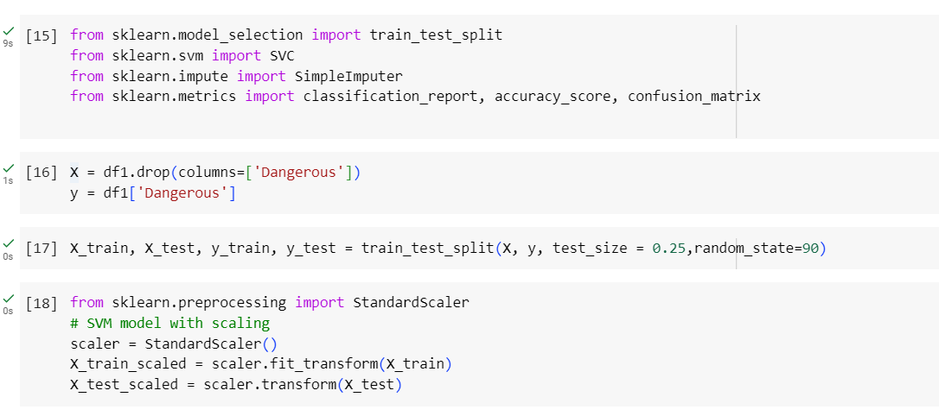

Slide 30
PHASE 4: MODEL BUILDING
We are using a SVM or Support Vector Machine for classification of the animals and their symptoms. SVM is a good fit for the same as it is a supervised learning model which uses some support vectors as critical data points to fit the margins more accurately than other models.

Slide 31
PHASE 4: MODEL BUILDING
Execute the Models Defined in Model Planning Phase:
Data Splitting: The dataset is split into training and testing sets using the train_test_split function.
Feature Scaling: Standardization is performed using the StandardScaler on both training and testing sets.
Model Training: A Support Vector Machine with a linear kernel is instantiated (SVC(kernel='linear', random_state=0)) and trained on the scaled training data.

Slide 32
PHASE 4: MODEL BUILDING
Develop Datasets for Training, Testing, and Production:
Training Data: X_train_scaled and y_train are used for training the SVM model.
Testing Data: X_test_scaled and y_test are used to evaluate the model's performance.

Slide 33
PHASE 4: MODEL BUILDING
The model appears to be valid and give accurate results.
The model accuracy is high so there is no immediate need for new parameters or inputs. More data can be used to train and improve accuracy though.
These models are very suitable for the runtime environment of a clinic as once trained they are very lightweight, efficient which is a requirement for real-time detection.
There is no need for a different kind of model needed to solve this problem in this current scenario.
The training accuracy is 97%. The testing accuracy is 98%. The model accuracy is 97.7%.

Slide 34
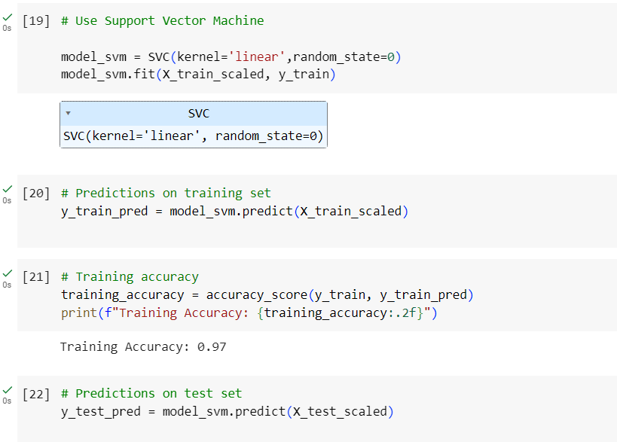

Slide 35
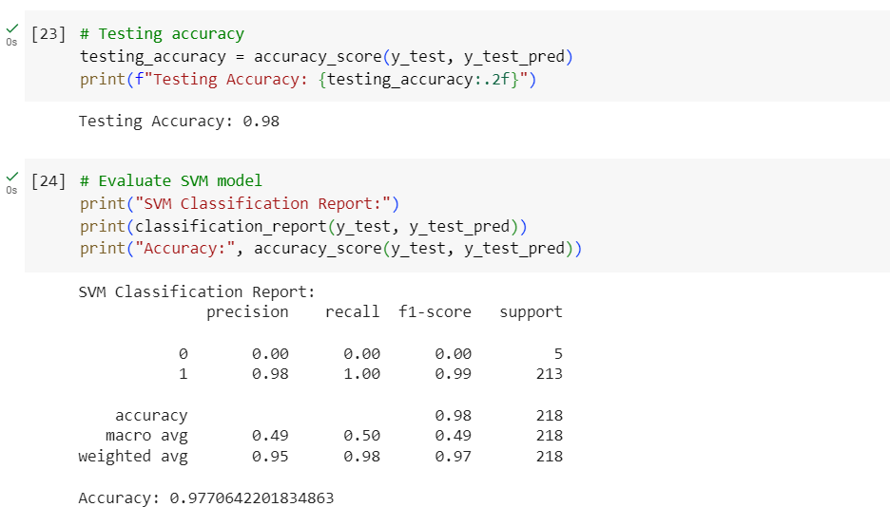

Slide 36
PHASE 5: COMMUNICATE RESULTS
Result Summary
The model predicts that the condition is dangerous. (or) The model predicts that the condition is not dangerous.
Key Findings:
Example 1:
The selected animal is classified as: Tiger
The chosen symptoms include: [Dry Air, Small Size, Inability to jump, Depression, Coughing]
Prediction Result: The model predicts that the condition is dangerous.

Slide 37
PHASE 5: COMMUNICATE RESULTS
Key Findings:
Example 2:
The selected animal is classified as: Chicken
The chosen symptoms include: [Slow Growth, Mild Weakness, Congestion, Trembling, Wound]
Prediction Result: The model predicts that the condition is not dangerous.

Slide 38
PHASE 5: COMMUNICATE RESULTS
Major Insights:
The team successfully achieved its objective in predicting dangerous conditions.
The results are statistically significant and valid based on the conducted analyses.

Slide 39
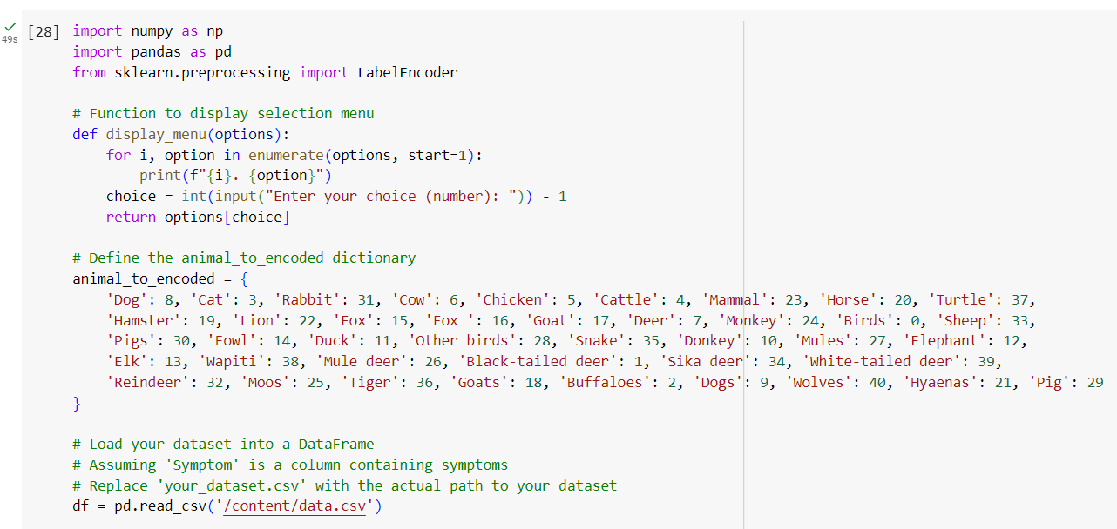

Slide 40
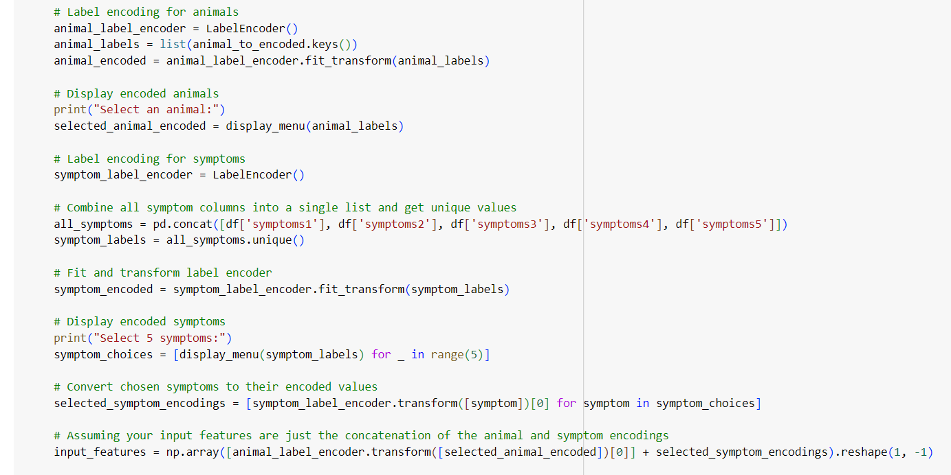

Slide 41
Final Prediction Part of the Code

Slide 42
PHASE 6: OPERATIONALIZE RESULTS
Key Findings
▶ The Animal ConditionsClassification ML Model achieved an accuracy rate of
97.7% in classifying animal conditions based on images.
▶ The model was trained on a dataset of close to 800 different instances of various animals and their corresponding symptoms.
▶ The top contributing factors for accurate classification were the presence of
visible injuries, body posture, and overall appearance of the animal.

Slide 43
PHASE 6: OPERATIONALIZE RESULTS
▶ The model showed high sensitivity in detecting severe conditions such as malnutrition.
▶ However, it struggled with classifying more subtle conditions like minor injuries or early signs of illness.
▶ To improve accuracy, additional data collection is recommended to include a wider variety of animal species and conditions.
▶ Basic BI activities, such as data cleaning and preprocessing, played a crucial
role in preparing the dataset for model training.

Slide 44
PHASE 6: OPERATIONALIZE RESULTS
▶ Future modifications for the animal conditions classification model could include incorporating additional features such as behavioral cues and vocalizations.
▶ Image analysis techniques, such as object detection and segmentation, can be explored to enhance the model's ability to identify specific anatomical features or abnormalities.

Slide 45


